Slide 1
Organizational
Effectiveness & Development
Notes:
The success rate for organizational effectiveness development is low, with estimates ranging from 30% to 50% of major change initiatives succeeding, though some sources claim a failure rate of 60% to 70%. Factors contributing to failure include poor communication, lack of leadership support, and an inability to align conflicting goals. While the widely cited "70% failure rate" for organizational change initiatives may lack consistent empirical evidence, numerous studies show that failure is more common than success. CHASING KPIs, not Behavior changes.
Most research (including McKinsey & Company and Boston Consulting Group) shows:~20–30% of OE / transformation efforts fully succeed~70–80% fall short or fail outright. A commonly cited stat: only ~12% of culture transformation initiatives succeed long-term (which aligns with what you referenced).

Slide 2
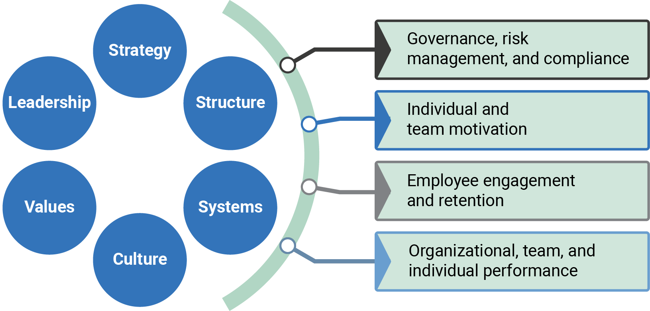
Organizational Model
Notes:
Structure—the way the organization separates and connects its pieces.
Systems—the policies that guide behavior and work, the processes that define how tasks will be performed, and the technology or tools used to support that work.
Culture—the set of beliefs, attitudes, values, and behaviors shared by members of the organization and passed on to new members.
Values—principles that the organization and its leaders have explicitly selected as a guide for decisions and actions.
Leadership—the model of behavior that leaders set for the rest of the organization.

Slide 3
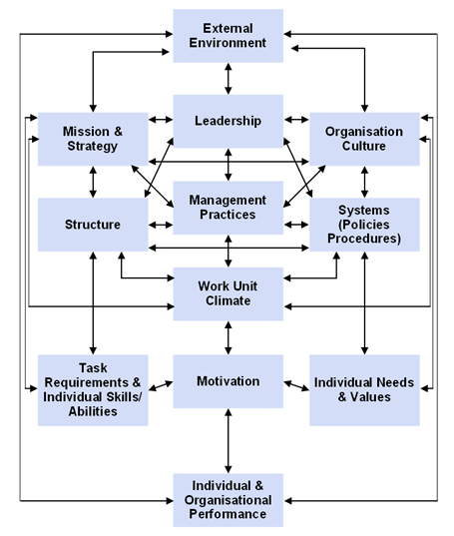
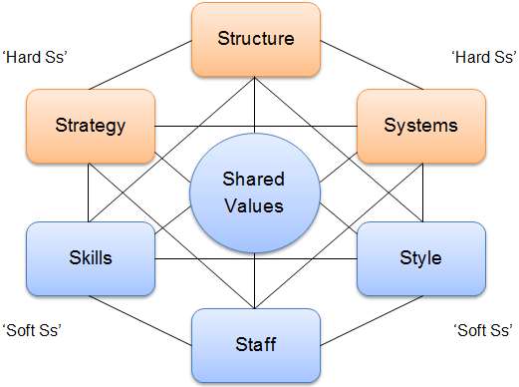

Organizational Model
McKinsey 7-S Framework
Burke-Litwin Perf & Change Model
Notes:
McKinsey -
Hard S :
Structure, strategy, systems
Soft S :
Skills, staff, style

Slide 4
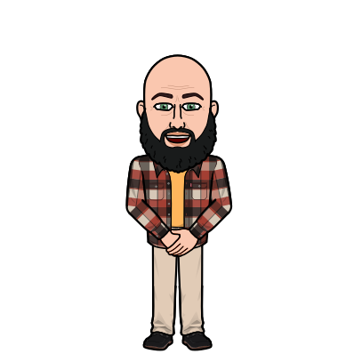
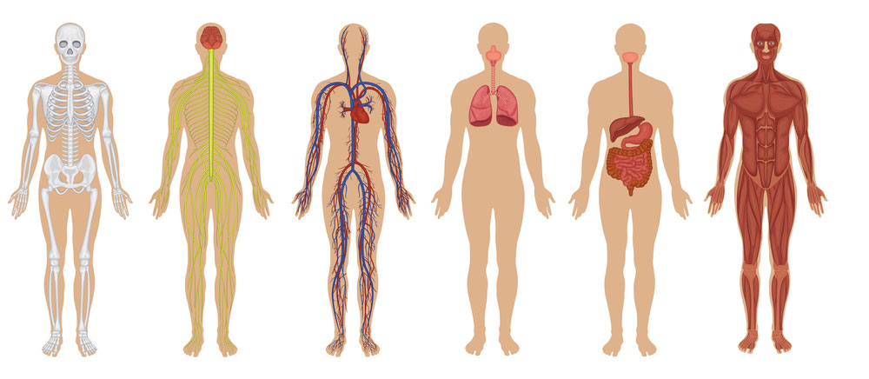
Organizational Model
Skeletal
Nervous
Circulatory
Respiratory
Digestive
Muscular
Strat
Structure
Systems
Skill
Staff
Style

Slide 5
OED Interventions
Interventions can be seen as stepping in to interrupt the status quo in order to examine a situation more closely and make changes that improve outcomes.
Proactive
Remedial

Slide 6
Characteristics of Effective Interventions
Strategically aligned
Collaborative
Supported by top management
Producing sustainable results
Supporting continuous improvement
Using common tools
Using common language
Explicit assumptions
Fact-based
Evidence-based
Oriented toward systems and processes
Flexibility
Multiple perspectives

Slide 7
Why Interventions Fail
Leadership does not get involved.
The wrong messengers are used.
Communication is:
  Too sudden.
  Too late.
  Not aligned with organizational realities.
  Too narrow.

Slide 8
Redesigning the Organization
Organizational design optimizes elements that support an organization’s functioning, including:
The organization’s mission and vision and the strategies it is pursuing to achieve its goals.
The way decisions are made.
The way information is communicated.
The processes used to perform work and the degree to which and how those processes connect parts of the organization’s structure.
The systems used to align the organization’s needs with the resources required to fill those needs.

Slide 9
Structural Characteristics in Organizational Design
Work specialization
Decision-making authority
Layers of hierarchy
Formalization
Notes:
Work specialization – Work cells, units
Decision making – job enrichment, centralized v. decentralized
Layers of hierarchy – span of control, # of direct reports, Span of control, chain of command
Formalization – SOPs, processes, policies

Slide 10
Organizational Structures
Functional
Product or customer
Geographic
Matrix

Slide 11
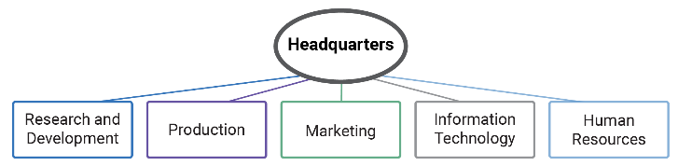
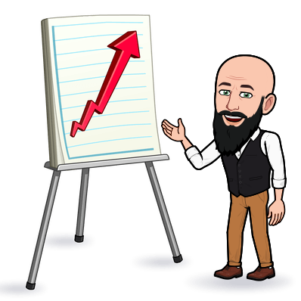
Functional

Slide 12
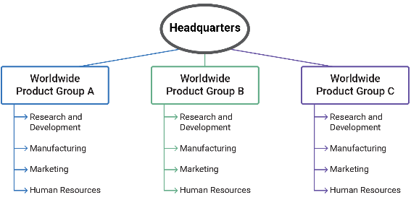
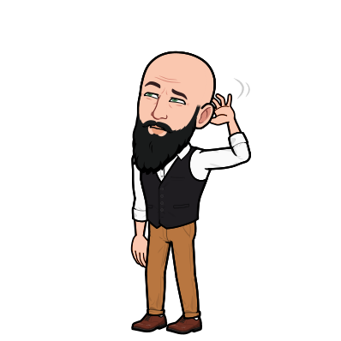
Product

Slide 13
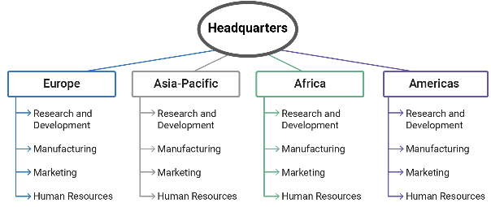
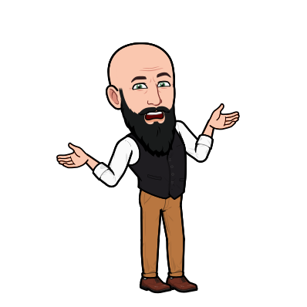
Geographic

Slide 14
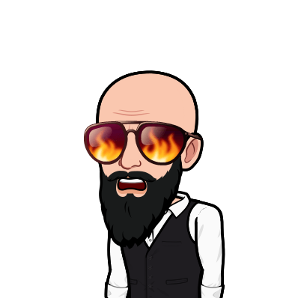
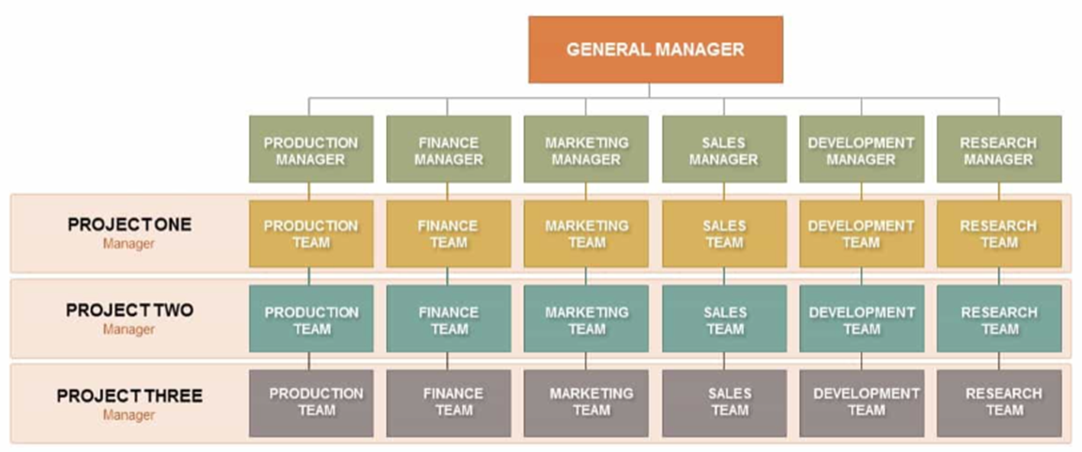
Matrix
Notes:
A responsible member will perform the activity
accountable member is in charge of the activity
consulted member provides advice
informed receive communication about activities

Slide 15
Assigning Roles in New Structures
The RACI matrix describes roles as: responsible (R), accountable (A), consult (C), and inform (I).
RACI matrices help an organization establish clarity around critical activities by assigning responsibility and describing communication needs.
Activity | John | Mary | Team leaders | George
Documenting changes | Responsible | Accountable | Consulting | Informed

Slide 16
Talent Development Interventions
Identify talent needs.
Identify competency deficiencies.
Develop existing staff.
Coordinate selection processes.
Develop comprehensive workforce development initiatives.
Build talent pool.
Communicate expectations.
Develop coaching or mentoring programs and internal social networks.
Clarify performance standards.
Notes:
Workforce Management

Slide 17
Organizational Culture Intervention
Describe the current culture.
Identify gaps and conflicts.
Develop change initiatives.
Identify the aspirational culture.

Slide 18
Team or Unit Interventions
Goal may be to improve team processes and interactions through:
Developing a team identity.
Correcting dysfunctional behaviors.
Redefining processes to remove conflicts and improve coordination.
Building trust and helping diverse teams overcome cultural and geographic distances.

Slide 19
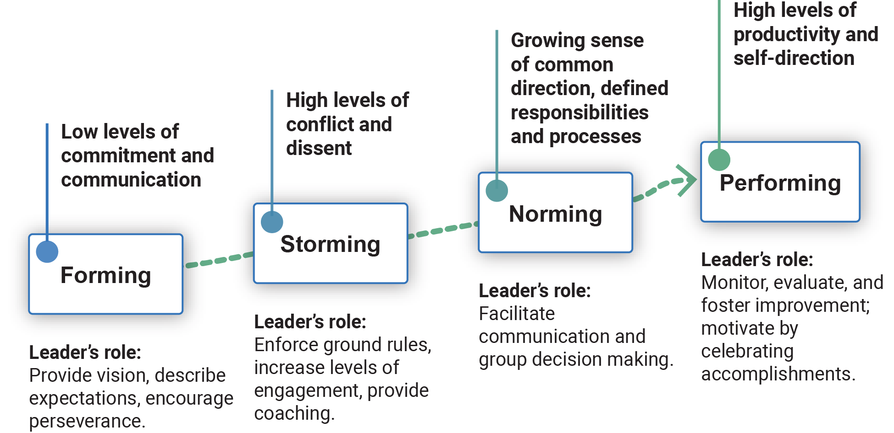
Team Formation
Based on Bruce Tuckman
Notes:
Forming. Members are polite, but there is little sense of trust, shared experience, or common values.
Storming. Individuals move past politeness, and there may be higher levels of discord as perspectives, styles, and agendas clash. This may be painful, but valuable communication is occurring.
Norming. build trust and establish relationships.
create rules that guide behavior.
establish a group identity and to identify “outsiders.” This can sometimes take a negative form; “group think” can impel members to adopt the same positions and reject outside views. This can dampen innovation and creative problem-solving.
Performing. The group becomes fully productive, collaborative, and mutually supportive.

Slide 20
Team Structure
Criteria that shape team structure:
  Skill diversity
  Authority dispersion
  Permanence
Notes:
Skill diversity – diversify your team
Authority dispersion – collaborative decision-making vs authoritative
Permanence – longevity of the team, project based or functional?

Slide 21
Group Dynamics
Group roles
  Task roles
  Social roles
  Dysfunctional roles
Based on Kenneth Benne and Paul Sheats
Notes:
Task roles – get it done
Social roles – mother hen
Dysfunctional roles – actively disengaged

Slide 22
Team Building
Team-building activities
  Activities may focus on:
  Goals and priorities.
  Roles and responsibilities.
  Processes.
  Interpersonal relationships.

Slide 23
Which organizational structure is best suited for an international organization that operates across several distinct industries in all regions in which it maintains a presence?
Knowledge Item #1
Matrix structure
Functional
Decentralized
Product structure

Slide 24
During which stage of Tuckman’s team development process is a leader mostly responsible for facilitating communication and group decision making?
Knowledge Item #2
Norming
Storming
Performing
Forming

Slide 25
Which of the following talent development tasks is most closely associated with a talent development intervention activity directed toward developing existing staff?
Knowledge Item #3
Communicate performance expectations
Identify competency deficiencies
Coordinate selection processes
Ensure current job descriptions are accurate

